Slide 1

Université de Mostaganem — Dr. Madani BELACEL
TD TIC 10 Services Internet EN
Module TIC — Dr. BELACEL Madani
Université de Mostaganem — MCB

Slide 2
Université de Mostaganem — Dr. Madani BELACEL
🎯 Objectifs pédagogiques
• Comprendre les concepts clés
• Appliquer les compétences
• Évaluer les technologies

Slide 3
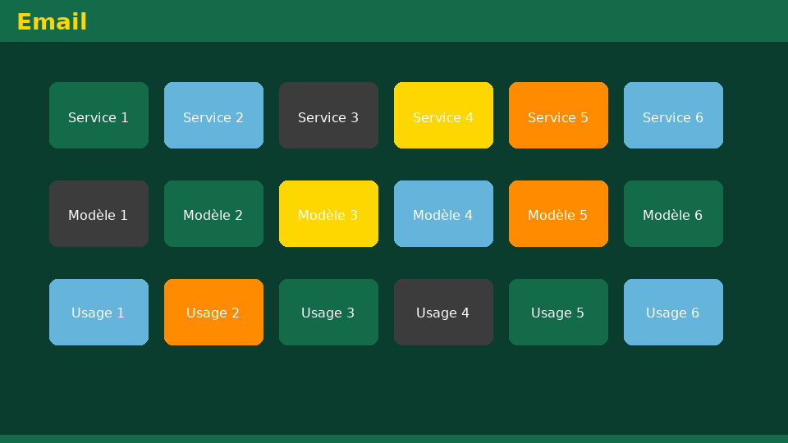
Université de Mostaganem — Dr. Madani BELACEL
📋 Plan du cours
• Exercise 1 — Search engine
• Exercise 2 — Professional email
• Exercise 3 — Email protocols
• Exercise 4 — File transfer
• Exercise 5 — ICT module summary

Slide 4

Exercise 1 — Search engine
• Statement:Explain the role of crawlers and the benefit of a metasearch engine.
• Detailed correction:- Crawlers: robots that explore the Web and index pages. - Metamotor: queries several engines, merges and deduplicates the results (e.g. Qwant, Dogpile).
Université de Mostaganem — Dr. Madani BELACEL

Slide 5
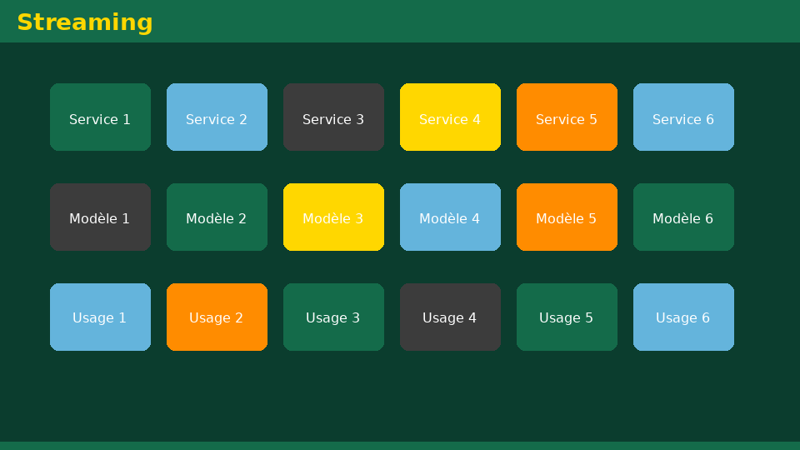
Exercise 2 — Professional email
• Statement:Write an email to a teacher to request a TD postponement (subject, formula, structure).
• Detailed correction:- Subject:[L1 Languages] TD TIC report request — Last name First name- Formula: “Madam, Sir,” - Body: brief reason, desired date, politeness. - Signature: name, group, institutional email. - Attachment only if supporting documentation requested.
Université de Mostaganem — Dr. Madani BELACEL

Slide 6

Exercise 3 — Email protocols
• Statement:Associate SMTP, POP, IMAP with: send, receive locally, multi-device sync.
• Detailed correction:- SMTP → sending. - POP → reception (often local download). - IMAP → reception with box sync on multiple devices (mobile + PC recommended).
Université de Mostaganem — Dr. Madani BELACEL

Slide 7

Exercise 4 — File transfer
• Statement:Compare USB key, Google Drive and email to submit a 15 MB assignment.
• Detailed correction:- USB key: fast in person, risk of loss/virus. - Drive: sharing link, traceability, institutional quota limit. - Email: attachment limit (~25 MB depending on server), practical for small files. → For 15 MB: Drive or Moodle platform preferred.
Université de Mostaganem — Dr. Madani BELACEL

Slide 8

Exercise 5 — ICT module summary
• Statement:Summarize the skills acquired in a 3-column table (Sessions 01-04, 05-06, 07-10).
• Detailed correction:| Block | Skills | |------|-------------| | 01-04 | Culture ICT, PC, Windows, Word | | 05-06 | Excel (calculation), PowerPoint (oral) | | 07-10 | Internet, Web, networks, digital services | → Complete digital culture for the Languages ​​Degree.
Université de Mostaganem — Dr. Madani BELACEL

Slide 9

• Statement:Explain the role of crawlers and the benefit of a metasearch engine.
• Statement:Write an email to a teacher to request a TD postponement (subject, formula, structure).
• Statement:Associate SMTP, POP, IMAP with: send, receive locally, multi-device sync.
📝 Points clés à retenir
Université de Mostaganem — Dr. Madani BELACEL

Slide 10

• Statement:Explain the role of crawlers and the benefit of a metasearch engine.
• Statement:Write an email to a teacher to request a TD postponement (subject, formula, structure).
• Statement:Associate SMTP, POP, IMAP with: send, receive locally, multi-device sync.
📝 Points clés à retenir
Université de Mostaganem — Dr. Madani BELACEL

Slide 11

• Statement:Explain the role of crawlers and the benefit of a metasearch engine.
• Statement:Write an email to a teacher to request a TD postponement (subject, formula, structure).
• Statement:Associate SMTP, POP, IMAP with: send, receive locally, multi-device sync.
📝 Points clés à retenir
Université de Mostaganem — Dr. Madani BELACEL

Slide 12

• Statement:Explain the role of crawlers and the benefit of a metasearch engine.
• Statement:Write an email to a teacher to request a TD postponement (subject, formula, structure).
• Statement:Associate SMTP, POP, IMAP with: send, receive locally, multi-device sync.
📝 Points clés à retenir
Université de Mostaganem — Dr. Madani BELACEL

Slide 13

Université de Mostaganem — Dr. Madani BELACEL
📝 Points clés à retenir
• Statement:Explain the role of crawlers and the benefit of a metasearch engine.
• Statement:Write an email to a teacher to request a TD postponement (subject, formula, structure).
• Statement:Associate SMTP, POP, IMAP with: send, receive locally, multi-device sync.
• Statement:Compare USB key, Google Drive and email to submit a 15 MB assignment.
• Statement:Summarize the skills acquired in a 3-column table (Sessions 01-04, 05-06, 07-10).

Slide 14

Université de Mostaganem — Dr. Madani BELACEL
✏️ Exercices d'application
• Définir les concepts principaux du cours
• Identifier les applications pratiques
• Résoudre les exercices du TD
• Synthétiser les points clés en un paragraphe
• Préparer une courte présentation orale

Slide 15
Université de Mostaganem — Dr. Madani BELACEL
🎓 Conclusion
Dr. BELACEL Madani Maître de Conférences B Université de Mostaganem madani.belacel@univ-mosta.dz

